Slide 1


Practitioners • Professional • Tenacious

Slide 2

Hi, My name is Kate Monserrate. I am one of the founding directors of Simplify Consulting. We are a practitioner led consultancy, specialising in transformational change, risk management, process optimisation and operating model design in the Wealth Management sector.
At Simplify Consulting, we are passionate about keeping things simple. So we have developed a series of short videos about Risk. They are aimed at people in the business, who have a limited or no understanding of risk. This is just an introduction and hopefully addresses some of the common misconceptions.
To make them a little more interesting, we have coupled risk with one of my favourite things...wine!
Stay safe…and cheers

Slide 3

What we will learn today
How to identify risks
How to articulate risks
How to manage risks through actions & controls
The difference between risks & risk events
Why is it important

Slide 4
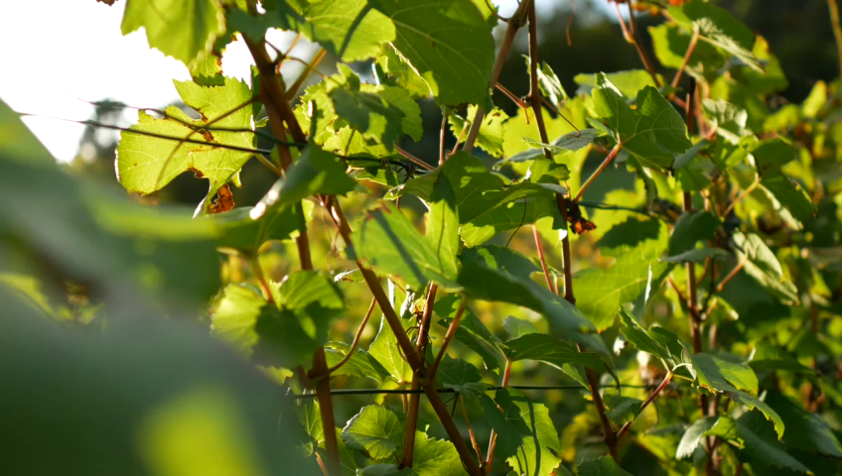
Producing wine is a great analogy for identifying, articulating and managing risk

Slide 5
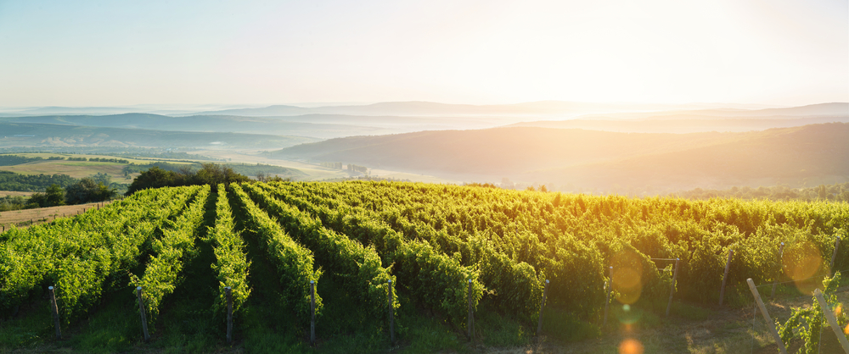

How do you identify your risks?
Identify the objective and purpose of what you are identifying risks for
This is relevant at any level. It could be a project, a team, a function, a product/service or an entire business
You then need to identify what threatens the achievement of those objectives along with the cause & impact

Slide 6

How do you identify your risks?
Identify the objective and purpose of what you are identifying risks for
In this particular example, the objective is “producing the best quality wine this season”

Slide 7







How to make wine…
4. Ageing
6. Consumption
2. Harvest
1. Growing & Maintenance
5. Bottling
3. Extract Juice, Fermentation & Filtration

Slide 8





Many factors can threaten the production of good quality wine in all parts of the process…identify all the factors through the process
External factors like the weather
The quality of the produce used
The vines, the soil etc.
The capability and
number of people
The planning of the process
and if there is enough time
The equipment used and
whether it is in good order
1. Growing & Maintenance
2. Harvest
3. Extract Juice, Fermentation & Filtration
4. Ageing
5. Bottling
6. Consumption

Slide 9
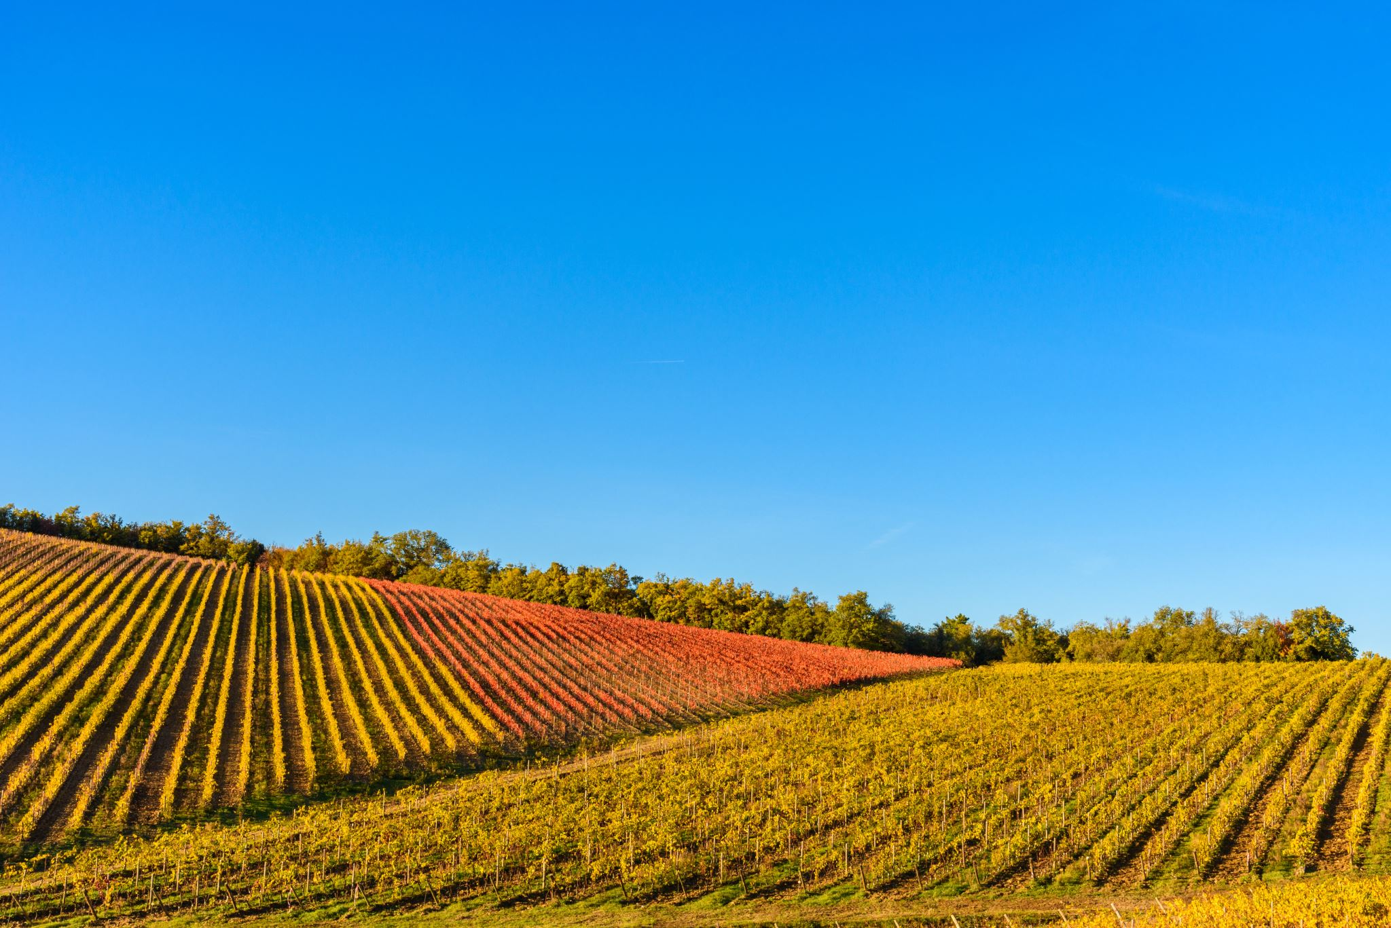
How do you articulate a risk?
An Example in the “Growing & Maintenance” Phase:
There is a risk that…
Due to…
Resulting in…
The description
The cause
The Impact
The grapes are not harvested
Not having enough people
Not having capable people
Poor planning
Less wine being produced
Poor quality wine being produced

Slide 10
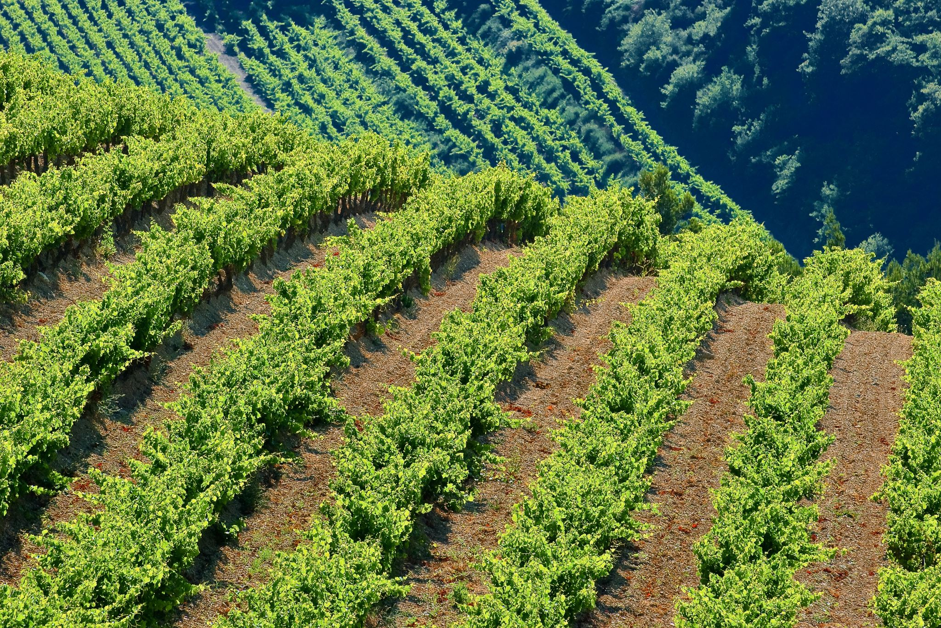
By writing your risks in this way…
There is a risk that…
Due to…
Resulting in…
…will help you determine what you can do to manage them.
It pinpoints what causes them and what would happen if that risk were to occur

Slide 11
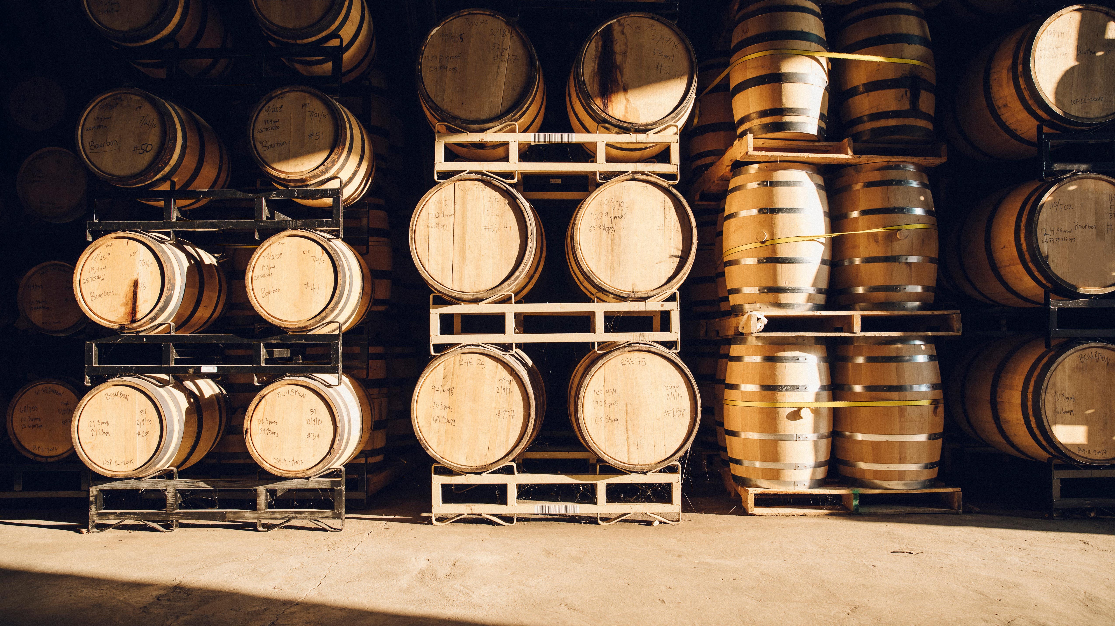
How to Manage Risks?
In this example, we have understood the causes of the grapes not being harvested.
If you think the risk is big enough to be worried about (i.e. the impact it has) and / or you think it is likely to happen (i.e. the likelihood), you can manage this risk through management actions and controls.

Slide 12
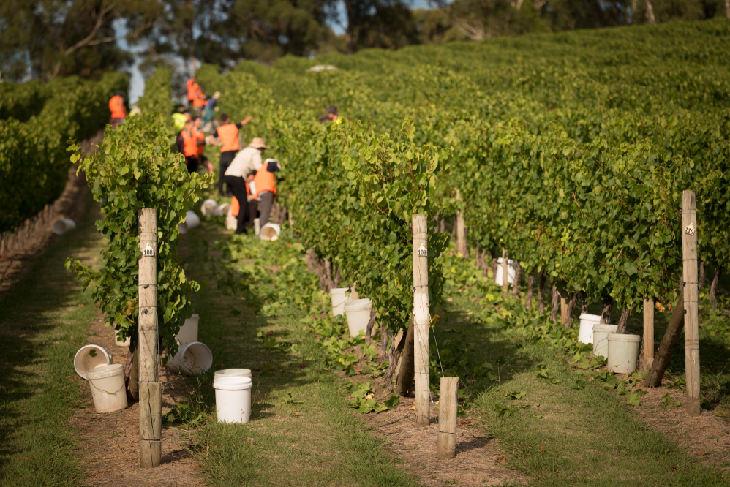






Control
How to Manage Risks? How to Manage the Causes?
Management Action
Not having enough people
Not having the right people
Not having enough time
Resource
Planning
Training
Planning
Recruitment process
Increase
resource
Pay & Reward
Can you think of an action or control…?

Slide 13
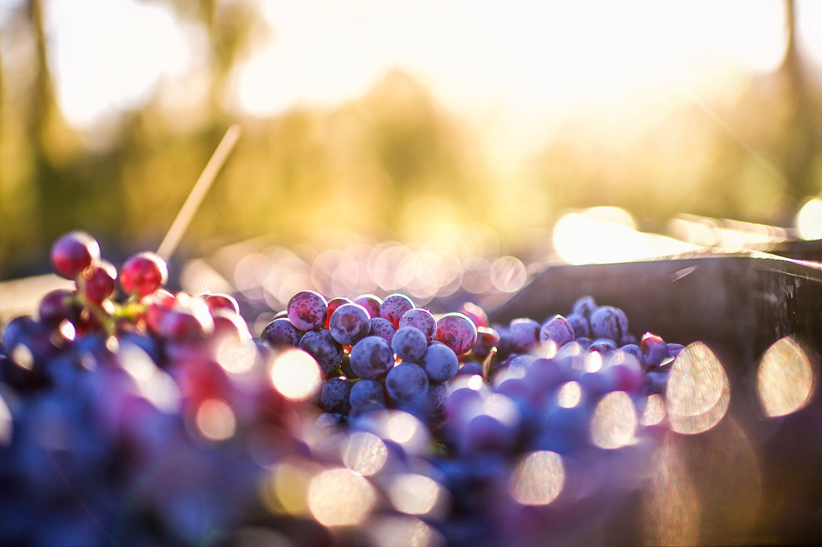
The Difference Between a Risk and a Risk Event
Risks
A threat or opportunity
It has not happened yet.
It only could happen.
Two dimensions are important – the likelihood of it happening and the impact if it were to happen.
Risk Events
Something that has happened already
Normally results in a financial loss i.e. costs money
A business normally sets a financial threshold and formally captures “risk events” that cost the business over a certain amount e.g. £5k
It is usually a control failure – something that has gone wrong in the process
There is a risk that the grapes are not harvested due to not having enough people, not having capable people and poor planning; resulting in less wine and / or poor quality wine being produced.
Not enough pickers were recruited for the growing season, which has resulted in 25% of the grapes not being harvested. This has resulted in 25% less revenue, resulting in a £100k loss for the vineyard.

Slide 14
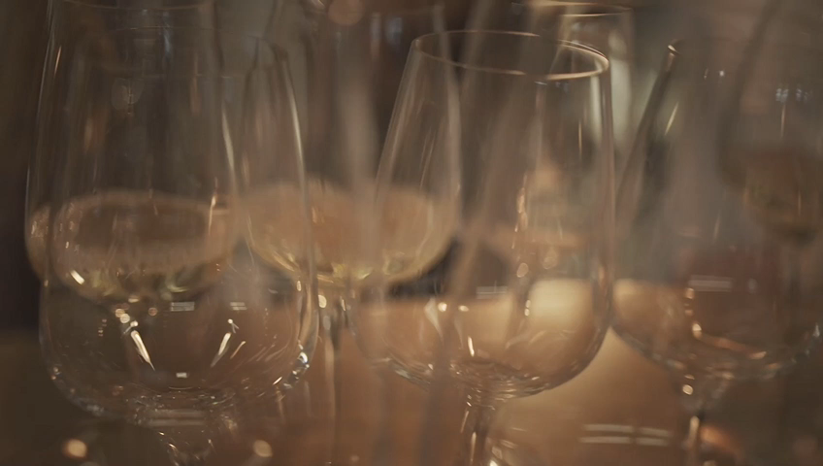
By identifying and managing your risks, you manage the threats to your business, team, process or product.
It is just common sense.
Cheers!

Slide 15

Practitioners • Professional • Tenacious
Simplify Consulting. It’s what we do.
www.simplifyconsulting.co.uk

